Slide 1


CUSTOMER SATISFACTION (CSAT) ANALYTICS
PROJECT: PRDA – 02 CSAT Analytics
Tools Used: MySQL, Power BI, Excel
Dataset: csat Dataset
Prepared by: Pranjali Pawar

Slide 2
PROJECT OBJECTIVE
The objective of this project is to analyze Customer Service Call Data, Provide useful Business Insights and identify Patterns that can help improve:
  Customer satisfaction
  Customer service performance
  Response time
  Call handling
  Service channels
  Overall customer experience

Slide 3
DATASET OVERVIEW
Main Features
  Customer information
  Sentiment
  CSAT score
  Call date
  Call reason
  City and state
  Communication channel
  Response time
  Call duration
  Call center
Dataset Information
  Total Records: 32,942
  Total Features: 13
  Data Source: MySQL Database
  Visualization Tool: Power BI

Slide 4
DATA PREPARATION & TRANSFORMATION
The data was first analyzed and validated using MySQL.
SQL Analysis
Power BI Transformation
  Database & Table Setup
  Column and data-type verification
  Duplicate ID checking
  NULL-value checking
  Category/value analysis
  CSAT statistics
  Call volume analysis
  Response-time analysis
  Call Duration analysis
  Sentiment analysis
  Corrected data types
  Converted call_timestamp to Date
  Verified data quality
  Checked for errors
  Loaded Transformed data into Power BI

Slide 5
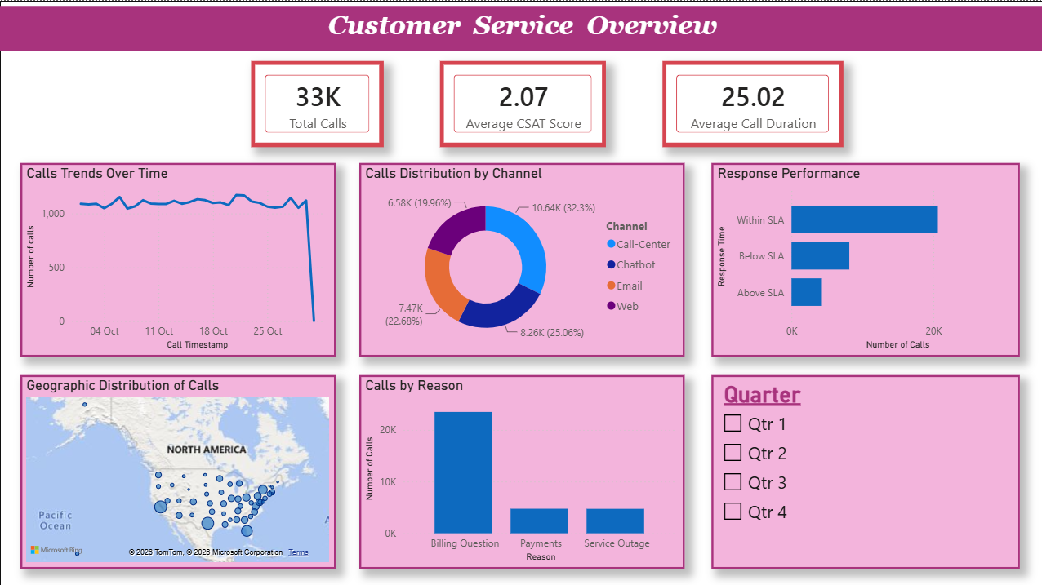
DASHBORAD OVERVIEW
  Total Calls: 33K
  Average CSAT Score: 2.07
  Average Call Duration: 25.02 minutes
  Call volume trend
  Channel distribution
  Response-time performance
  Geographic distribution
  Call reasons

Slide 6
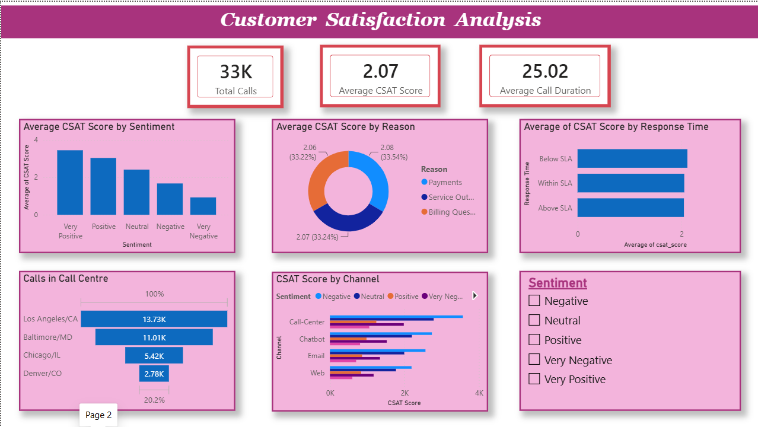
CSAT AND SENTIMENT
  Total Calls: 33K
  Average CSAT Score: 2.07
  Average Call Duration: 25.02 minutes
  Average CSAT Score by Sentiment
  Calls in Call Centre
  CSAT Score in channels
  Response-time
  Call reasons
  Sentiments

Slide 7
CALL TRENDS & CHANNELS
From the dashboard:
  The dataset contains approximately 33K customer calls.
  Call volume remains relatively consistent across most of the displayed period.
  The Call-Center channel accounts for the largest share of calls at approximately 32.3%.
  Chatbot accounts for approximately 25.1%.
  Email accounts for approximately 22.7%.
  Web accounts for approximately 20.0%.

Slide 8
CALL REASONS & RESPONSE PERFORMANCE
Dashboard Shows:
  Billing Questions represent the largest share of calls.
  Payments and Service Outage are the other major call reasons.
  Most calls fall under the Within SLA response category.
  Calls categorized as Below SLA form the second-largest response group.
  Above SLA represents the smallest response-time category.

Slide 9
CUSTOMER SATISFACTION
ANALYSIS
Dashboard Shows a clear difference in average CSAT across sentiment categories.
  Very Positive calls have the highest average CSAT.
  Positive calls have a higher average CSAT than Neutral and Negative calls.
  Negative sentiment is associated with a considerably lower average CSAT.
  Very Negative calls have the lowest average CSAT.
  Overall average CSAT is 2.07.

Slide 10
SERVICE PERFORMANCE ANALYSIS
From the dashboard:
  Call volumes differ across call centers.
  Los Angeles/CA has the highest call volume among the displayed call centers.
  Baltimore/MD has the second-highest volume.
  Chicago/IL follows Baltimore/MD.
  Average CSAT varies across different service categories and response-time groups.

Slide 11
KEY INSIGHTS
  The dataset contains approximately 33K customer service calls, with an overall average CSAT score of 2.07.
  Call-Center is the most frequently used channel, accounting for approximately 32.3% of calls.
  Billing Questions are the most common reason for customers contacting the service center.
  Most calls are classified as Within SLA, while a smaller proportion fall into the Below SLA and Above SLA categories.
  Average CSAT varies substantially by sentiment, with Very Positive calls showing the highest average CSAT and Very Negative calls showing the lowest.
  The average call duration is approximately 25.02 minutes.
  Call volumes vary across call centers, with Los Angeles/CA showing the highest volume among the displayed centers

Slide 12
BUSINESS SUGGESTIONS
Based on the analysis:
  Improve self-service resources for frequently occurring billing-related queries.
  Monitor calls falling into the Above SLA category and identify causes of delayed responses.
  Review service processes for calls associated with Negative and Very Negative sentiment.
  Strengthen high-volume channels while maintaining service quality across all channels.
  Analyze high-volume call centers to identify workload and staffing requirements.
  Use CSAT and sentiment trends as regular customer-service performance indicators.

Slide 13
CONCLUSION
The CSAT analysis provides an overview of customer service performance across call volume, channels, reasons, response time, sentiment and customer satisfaction.
The analysis shows that combining SQL-based data analysis with Power BI visualization can help identify customer-service patterns and areas that require operational attention.

